Slide 1
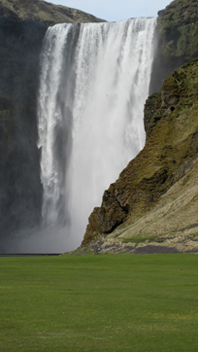
Health Care Water Conservation and Pollution Prevention
Hermine Levey Weston, RN MBA Member Engagement Manager
Notes:
Photo credit: Hermine Levey Weston, Iceland 2011.
Practice Greenhealth hopes that this presentation will be used to frame the imperative for water conservation in health care.

Slide 2
Water is Life
“Water is the driver of nature”
- Leonardo da Vinci
“It’s the briny broth of our origins, the pounding circulatory system of the world. We stake our civilizations on the coasts and mighty rivers. Our deepest dread is the threat of having too little—or too much”
- Barbara Kingsolver
Notes:
Healthcare use: Water quality and availability are both essential to protecting patient health and critical to daily hospital operations. Water is used for everything from sanitation and instrument sterilization to heating and cooling. Water efficiency measures such as improved use of chiller condensate can save hospitals millions of gallons of water which translates into thousands of dollars saved.
· Cost: Hospitals and clinics are saving $1,119,404 annually through conservation efforts. They saved > 275 million gallons of water in 2014 Source PGH benchmark report.
· Water Pollution: Public health is impacted by high quality access to water for food production, sewage treatment and sanitation. Healthcare organizations can protect their communities by being good stewards of resources and responsibly handling chemical, pharmaceutical and solid waste streams.
· Current water shortage and connections to climate change: Extreme drought in the Southwestern US is connected to climate change as well as historically poor stewardship of the resource. There is currently a negative feedback loop with water drilling and a decreased water table. In January 2014, Gov. Jerry Brown (D) declared a state of emergency over the drought and directed state agencies to take steps to prepare for water shortfalls. And a few months ago the State Water Resources Control Board adopted emergency regulations calling for a 25% decrease in overall urban water use across the state. Currently hospitals are expected to end landscape irrigation while most are working to improve water conservation in many areas.
· Water and Food connections: Water shortages in the Southwestern part of the United States could be connected to food price increases or shortages. A patty of hamburger takes about 450 gallons of water to produce. It is important to consider water footprint for common goods used in hospitals such as meat, dairy products, fruits and vegetable, cotton and coffee.
· Water Table Depletion: Public health and food security can be impacted by drilling for water in California which is causing underground water levels to fall dangerously low..
· Disaster preparedness: Healthcare organizations must have a supply of safe drinking water to maintain operations during natural or manmade disasters.
· Opportunities for Improvement: According to the Practice Greenhealth 2015 Sustainability Benchmark Report, less than 30% of Partner for Change Award applicants conducted a water audit.

Slide 3
What is the water footprint of common goods?
One pound of ground beef
One pound of sausage
One pound of beans
One pair of blue jeans
1,857 gallons
1,382 gallons
43 gallons
2,900 gallons
Notes:
Virtual water for beef includes the water they drink and the water used to grow their feed and clean their waste. One hamburger is 634 gallons
Virtual water for processed food includes water used to raise the animal and process the edible end product
Virtual water for vegetables and fruit includes both rain water and irrigation
Virtual water for cotton includes water used irrigate the crop and to dilute wastewater from fertilized fields plus water used to transform cotton into fabric. Source: National Geographic Special Issue Water our Thirsty World April 2010. Calculation tool developed by Dutch Scientist Arjen Hoekstra at UNESCO and the University of Twente

Slide 4
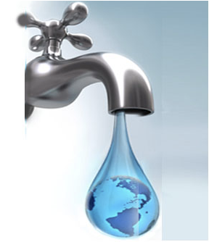
Water Accounting for the Partner for Change Award?
Annual Water Consumption
Gross Square Area
Cleanable Square Area
Total Landscape Area= Irrigated Landscape + Non irrigated landscape
Water saving devices and purchase price
Project descriptions
Notes:
Cleanable Area The actual surface areas of floors, walls, windows, sills, furniture, fixtures and equipment that require cleaning in order to maintain sanitary conditions and good appearance.
Gross Floor Area (per ES) Gross Floor Area is defined as the total floor area, expressed in square feet or square meters, measured from the principal exterior surfaces of the building(s) and not including parking area(s)

Slide 5
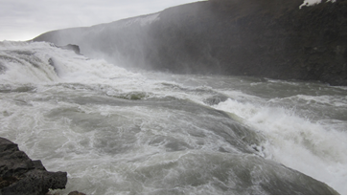
What are the 2015 water benchmarks for Practice Greenhealth Award Winning Hospitals?
Metric | Median | Circle of Excellence Water
Gallons per Sq. Ft | 42.9 gallons | 29.3 gallons
Gallons per Cleanable Sq. Ft | 47.9 gallons | 37.26 gallons
% Change in Water Use per Sq. Ft. | 9.0% | 32.5%
Gallons of Water per OR | 2.2 million gallons | 2.08 million gallons
Notes:
If you applied for a Partner for Change award last year, you will receive a metric report card soon that will compare your water performance with the median and top performers. This chart demonstrates that even top performers have opportunities in water conservation
Photo credit: Hermine Levey Weston, Iceland 2011

Slide 6
2016 Water Goals
Level 1: Determine Water Usage Baseline
Level 2: Percent change in gallons of water used per square foot of gross floor area between baseline and current year or Gallons of water used per square foot of gross floor area in current year
Level 3: Percent change in gallons of water used per square foot of gross floor area between baseline and current year or Gallons of water used per square foot of gross floor area in current year

Slide 7
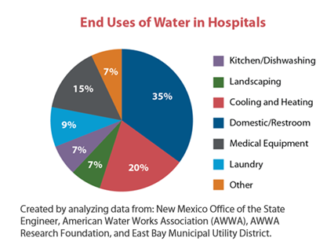
Evaluate Water Consumption
*WaterSmart Guidebook 2008
Notes:
This graphic demonstrates the water use from one hospital in New Mexico. A water audit is needed for each individual facility to ascertain water use. In general hospitals will use the 80/20 rule, focusing improvement attention on the largest users of water, but there is value in working with the lesser use of water. For instance, in drought stricken areas the public will not expect to see a hospital watering a lawn! This is where hospitals have changed the way they irrigate their landscape in order to meet regional water reduction requirements and community expectations, even though the actual water reduction is small in comparison with other areas.

Slide 8
Best Practices from NorthShore University Health System and Kaiser Permanente San Jose Medical Center
Thanks to:
Keefe Fields, Chief Engineer, Cindy Soliday and Elizabeth Bailey, Green Team Co-Chairs at KP
Michael J. Fiore, CIH, CSP, Director, Environmental Occupational Health and Safety/Sustainability at NorthShore University Health System
Notes:
The following slides were presented in the summer of 2015 in response to the water emergency in the state of California

Slide 9
Identify Conservation Opportunities at NorthShore University Health System
Steam Trap Audit
Increase Cooling tower cycles
New SPD equipment
Notes:
These were goals for NorthShore University Health System, a 4 hospital system in the greater Chicago Illinois area.

Slide 10
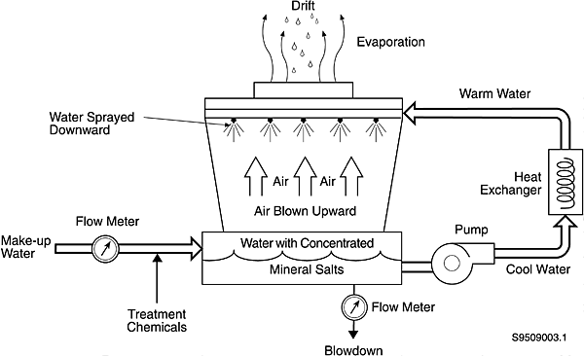
Increase Cooling Tower Cycles
Increase cooling tower cycles through use of acid treatment (control/prevent mineral scale).
Results in decreased blowdown and associated make-up water needed.

Slide 11
Increase Cooling Tower Cycles- Impact
Location | Cycles 2014 | Current Annual Make-up Usage | Cycles Present | Est. Make-up Usage | Water Savings (Gals) | Water $ Savings
Glenbrook | 4 | 4,006,800 | 8 | 3,464,400 | 572,400 | $4,047
Skokie | 4 | 5,827,680 | 8 | 4,996,080 | 831,600 | $4,283
Highland Park | 4 | 5,827,680 | 8 | 4,996,080 | 831,600 | $4,283
Total |  | 15,662,160 |  | 13,426,560 | 2,235,600 | $12,403
Notes:
These are impressive impacts of the planning, investment and execution of water management

Slide 12
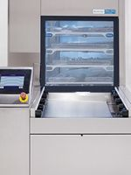
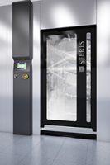
New Sterile Processing Department Equipment
Instrument Washer/Disinfectors (STERIS Vision)
Uses 41.1 gallons of cold, hot and pure water per cycle.
Represents a 19% reduction compared to previous washers.
Cart Washer (STERIS Vision)
Recycles the rinse water (70%) from each previous cycle to conserve water, using only 14 gallons of (new) hot water per cycle.
Represents a 36% reduction in water usage when compared to previous cart washer.
Notes:
Focus on Sterile Processing yielded impressive water savings at NorthShore

Slide 13
Approximately 1.3 acre storm water retention pond NorthShore University HealthSystem, Glenbrook campus
Notes:
Water retention pond adds beauty as well functionality.

Slide 14
Water Conservation at Kaiser Permanente San Jose Medical Center Keefe Fields Chief Engineer Cindy Soliday and Elizabeth Bailey Green Team Co-Chairs
July 29, 2015
Notes:
The following slides were presented in the summer of July 2015 to members of the Practice Greenhealth. They demonstrate the commitment of Kaiser Permanente to be good stewards of water in their drought stricken community.

Slide 15
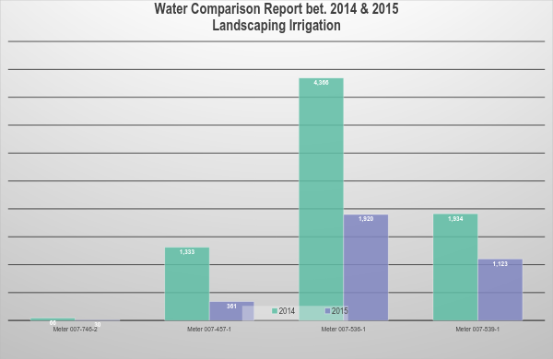
* per ccf. x 748 = 748gal.
Notes:
You manage what you measure as the following slides demonstrate

Slide 16
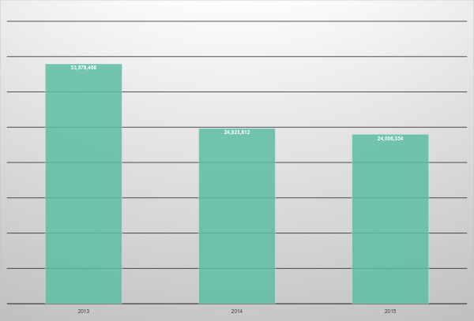

Slide 17
Successes
2014: 26.7% reduction in water use even with an increase of 8000 patients at our facility (4% increase)
Landscape water use
SMART controllers for landscaping: Sense the actual temperature of the weather and adjust accordingly. Sensitive to fog, rain, humidity, temperature and adjust watering amounts and frequency.
High efficiency nozzles for sprinklers and drip systems that use less water
Drought resistant planting
Campus fountains all use recycled water or have been shut off
It is anticipated that 3.2 million gal of water will be saved over the course of a year due to these projects

Slide 18
Additional Successes
Cooling towers go through blow down after 6 cycles instead of 5 as in previous years. Therefore, draining of the cooling tower occurs less frequently leading to less wasted water.
Replaced 40 year old boilers with new high efficiency boilers resulting in less water and energy usage
Installed all low flow toilets and faucets in public bathrooms
Green Team rounds looking for leaks and other opportunities
Education of all managers on water conservation efforts and what they can do to get involved and assist with effort; e.g. full loads for EVS laundry, sterile processing, and dishwashing
Expired water kept in storage for emergencies was used to water the grounds

Slide 19
Challenges
Capitol investment for new landscaping controllers in additional locations
Education/training staff to use new equipment
Assessing the possible risk of too much mineral build up in cooling towers (test of change for engineering). No damage yet, may be able to take it even further.
Broadening our educating staff and members to be mindful of water conservation in general
Staff not reporting of leaks found in departments or public spaces in a timely manner
Some other facilities are hearing complaints about not enough flow in the toilets/sinks
Continued need to convert landscaping to drought resistant plants

Slide 20
Future projects
Complete the test of change for cooling towers to see if can further increase the cycle number before blow down
Keep water conservation in mind as we expand to 2 new sites and further increase our services and membership
Installation of additional SMART irrigation controllers to outlying areas on our campus

Slide 21
Resources:
Practice Greenhealth Less Water Toolkit
Conservation at Providence St. Peter Hospital
Case Study: Water Conservation in Sterile Processing at Stanford University Medical Center
Greenhealth Magazine: H2O in the OR- Saving Water at Lehigh Valley Hospital-Cedar Crest
Notes:
Please visit the water topic page on the Practice Greenhealth website for the latest resources for water management.

Slide 22
Next Steps
Please contact your member engagement manager for more resources.
Visit the Practice Greenhealth Water Topic Webpage
Contact Hermine Levey Weston 888 521 6664 hleveyweston@practicegreenhealth.org

